Slide 1

Queuing Theory and its Applications
Prepared by
Debasis Mohanty (UEBA19001)

Slide 2
Topics to be discussed
1
What is a Queue?
3
Queue Models its requirements and its types?
4
Queue Distributions and Performances
5
Model Analysis
2
A basic Queue model and its importance
6
Simulation

Slide 3
What is a Queue ?
Queueing theory is the mathematical study of waiting lines.
Now why waiting lines are created?
Waiting lines are created due to variations. Variations in arrival and service provided.
To understand these variations is details a queueing model is constructed so that the variations in, waiting time and service time can be predicted.
Why do we even need these predictions? How it is going to help us?
These predictions will help us in improving the efficiency of a system.
In our day to day life we come across many services and we provide services too. These services consumes time and costs, so to optimize it, we study queueing theory.

Slide 4
A basic Queue model
A basic business Queue model have two approaches:
Analytical Model: The one which is built on differential equations which has arrivals and services.
Simulation: Complex system with multiple stations (For e.g. CAT Exam, Air Traffic controller)
GOAL : To minimize the service and waiting costs, to reduce the waiting time of customers and optimize the service time because the resources are limited
Service costs are the salary or wages which any business must bear
Waiting costs are those which company have to bear due to following reasons:
Balking: Leaving the queue without buying as the line is too long
Renege: Joined the line got bored or running out of time so left the queue
Attrition: Buy and never return

Slide 5
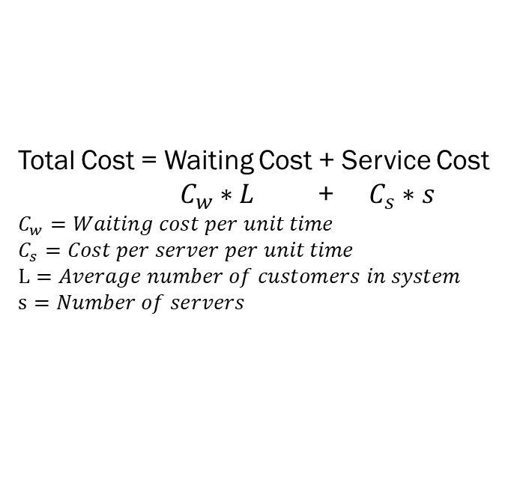
Why we model Queue and its importance
Total Cost = Waiting cost + Service cost
Total Cost = Waiting Cost + Service Cost
$C_{w}∗L$ + $C_{s}∗s$
$$C_{w}=Waiting cost per unit time$$
$$C_{s}=Cost per server per unit time$$
$$L=Average number of customers in system$$
$$s=Number of servers$$
Expected cost per unit time
Optimal Service Level
Service Cost
Waiting Cost
Number of servers

Slide 6
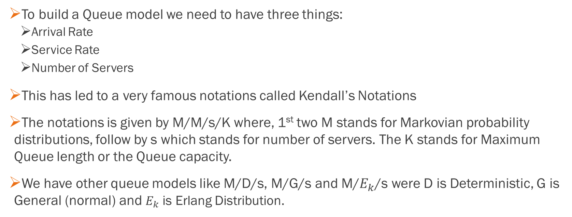
Queue Model requirements and types
To build a Queue model we need to have three things:
Arrival Rate
Service Rate
Number of Servers
This has led to a very famous notations called Kendall’s Notations
The notations is given by M/M/s/K where, 1st two M stands for Markovian probability distributions, follow by s which stands for number of servers. The K stands for Maximum Queue length or the Queue capacity.
We have other queue models like M/D/s, M/G/s and M/$E_{k}$/s were D is Deterministic, G is General (normal) and $E_{k}$ is Erlang Distribution.

Slide 7
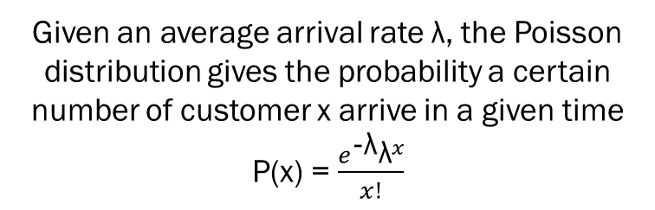
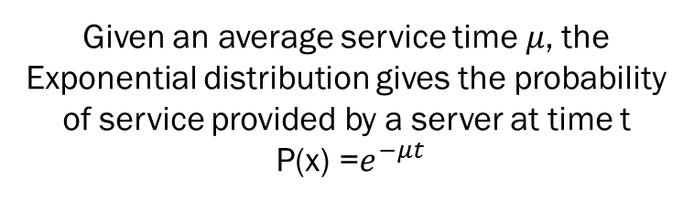
Queues Distributions
Given an average arrival rate λ, the Poisson distribution gives the probability a certain number of customer x arrive in a given time
P(x) = $\frac{e^{\text{−}\text{λ}}{\text{λ}}^{x}}{x!}$
Given an average service time 𝜇, the Exponential distribution gives the probability of service provided by a server at time t
P(x) =$e^{−μt}$

Slide 8
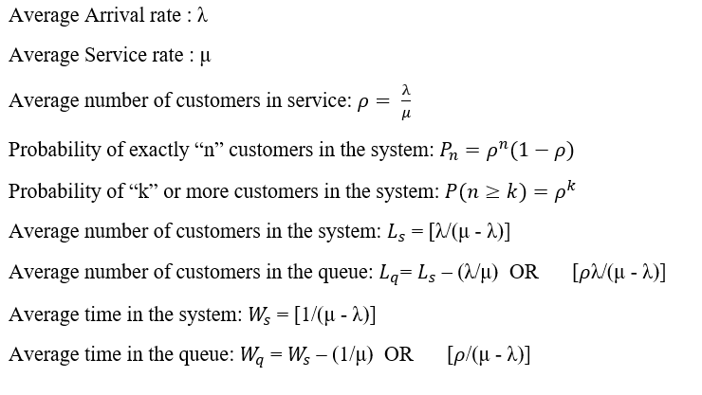
Queues Performance Measures M/M/1

Slide 9
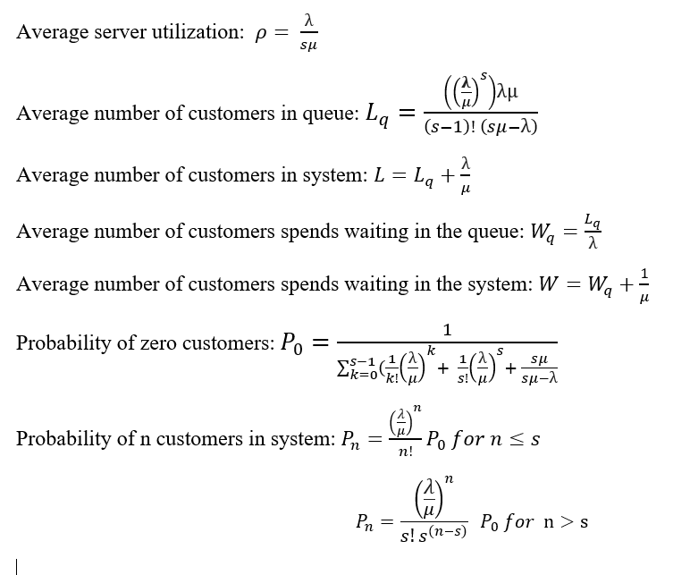
Queues Performance Measures M/M/s

Slide 10

Model Analysis
Queue Performance/Operating Characteristics at steady state | s = 1 | s = 2 | measure
Average server utilization (𝜌) | 67% | 33% | busy
Average number of customers in the queue (Lq) | 1.3333 | 0.0833 | in queue
Average number of customers in the system (L) | 2.0000 | 0.7500 | in system
Average waiting time in the queue (Wq) | 0.6667 | 0.0417 | hour
Average time in the system (W) | 1.0000 | 0.3750 | hour
Probability (% of time) system is empty (Po) | 0.3333 | 0.5000 | empty
PROBLEM STATEMENT I: The County Hospital Example with the M/M/s Model. For the County Hospital emergency room problem, the management engineer has concluded that the emergency cases arrive pretty much at random (a Poisson input process), so that interarrival times have an exponential distribution. She also has concluded that the time spent by a doctor treating the cases approximately follows an exponential distribution. Therefore, she has chosen the M/M/s model for a preliminary study of this queueing system. By projecting the available data for the early evening shift into next year, she estimates that patients will arrive at an average rate of 1 every $\frac{1}{2}$ hour. A doctor requires an average of 20 minutes to treat each patient. What is the queue performance at steady state? Do we require one more doctor?

Slide 11
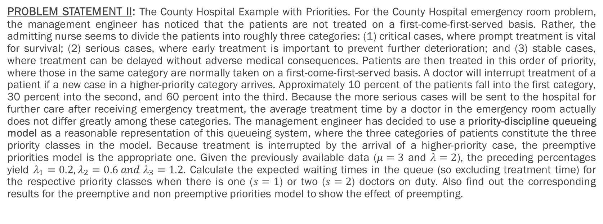
Model Analysis
PROBLEM STATEMENT II: The County Hospital Example with Priorities. For the County Hospital emergency room problem, the management engineer has noticed that the patients are not treated on a first-come-first-served basis. Rather, the admitting nurse seems to divide the patients into roughly three categories: (1) critical cases, where prompt treatment is vital for survival; (2) serious cases, where early treatment is important to prevent further deterioration; and (3) stable cases, where treatment can be delayed without adverse medical consequences. Patients are then treated in this order of priority, where those in the same category are normally taken on a first-come-first-served basis. A doctor will interrupt treatment of a patient if a new case in a higher-priority category arrives. Approximately 10 percent of the patients fall into the first category, 30 percent into the second, and 60 percent into the third. Because the more serious cases will be sent to the hospital for further care after receiving emergency treatment, the average treatment time by a doctor in the emergency room actually does not differ greatly among these categories. The management engineer has decided to use a priority-discipline queueing model as a reasonable representation of this queueing system, where the three categories of patients constitute the three priority classes in the model. Because treatment is interrupted by the arrival of a higher-priority case, the preemptive priorities model is the appropriate one. Given the previously available data ($μ=3$ and $λ=2$), the preceding percentages yield $λ_{1}=0.2,λ_{2}=0.6 and λ_{3}=1.2$. Calculate the expected waiting times in the queue (so excluding treatment time) for the respective priority classes when there is one ($s=1$) or two ($s=2$) doctors on duty. Also find out the corresponding results for the preemptive and non preemptive priorities model to show the effect of preempting.

Slide 12
What is Priority-Discipline Queues
In priority-discipline queueing models, the queue discipline is based on two priority system.
Static : Doesn’t change throughout the execution
Dynamic: Changes after some time
We have two models based on priority system. They are:
Non-Preemptive Priorities model
Preemptive Priorities model
With non-preemptive priorities, a customer being served cannot be ejected back into the queue (preempted) if a higher-priority customer enters the queueing system. Therefore, once a server has begun serving a customer, the service must be completed without interruption.

Slide 13
What is Priority-Discipline Queues
With preemptive priorities, the lowest-priority customer being served is preempted (ejected back into the queue) whenever a higher-priority customer enters the queueing system. A server is thereby freed to begin serving the new arrival immediately.
When a server does succeed in finishing a service for a higher priority customer, so a preempted customer normally will get back into service again and will eventually finish its treatment after waiting again in the queue.
Both the queue model will follow queue discipline of FIFO according to its priority.

Slide 14
Priority-Discipline Queues algorithm (Non-Preemptive)
Non-Preemptive Priority Queue Algorithm
Patients | Priority | Arrival Time | Burst Time | System Time (Completion Time) | Turnaround Time (ST - AT) | Waiting Time (TT - BT)
P1 | 3 | 0 | 8 | 8 | 8 | 0
P2 | 4 | 1 | 2 | 17 | 16 | 14
P3 | 4 | 3 | 4 | 21 | 18 | 14
P4 | 5 | 4 | 1 | 22 | 18 | 17
P5 | 2 | 5 | 6 | 14 | 9 | 3
P6 | 6 | 6 | 5 | 27 | 21 | 16
P7 | 1 | 10 | 1 | 15 | 5 | 4
Total |  |  |  | 124 | 95 | 68
Priority Q | P1 | P5 | P7 | P2 | P3 | P4 | P6
0 | 8 | 14 | 15 | 17 | 21 | 22 | 27

Slide 15
Priority-Discipline Queues algorithm (Preemptive)
Preemptive Priority Queue Algorithm
Patients | Priority | Arrival Time | Burst Time | New BT | System Time (Completion Time) | Turnaround Time (ST - AT) | Waiting Time (TT - BT)
P1 | 3 | 0 | 8 | 3 | 15 | 15 | 7
P2 | 4 | 1 | 2 |  | 17 | 16 | 14
P3 | 4 | 3 | 4 |  | 21 | 18 | 14
P4 | 5 | 4 | 1 |  | 22 | 18 | 17
P5 | 2 | 5 | 6 | 1 | 12 | 7 | 1
P6 | 6 | 6 | 5 |  | 27 | 21 | 16
P7 | 1 | 10 | 1 |  | 11 | 1 | 0
Total |  |  |  |  | 125 | 96 | 69
Priority Q | P1 | P5 | P7 | P5 | P1 | P2 | P3 | P4 | P6
0 | 5 | 10 | 11 | 12 | 15 | 17 | 21 | 22 | 27

Slide 16
Non-Preemptive Priorities model

Slide 17
Preemptive Priorities model

Slide 18
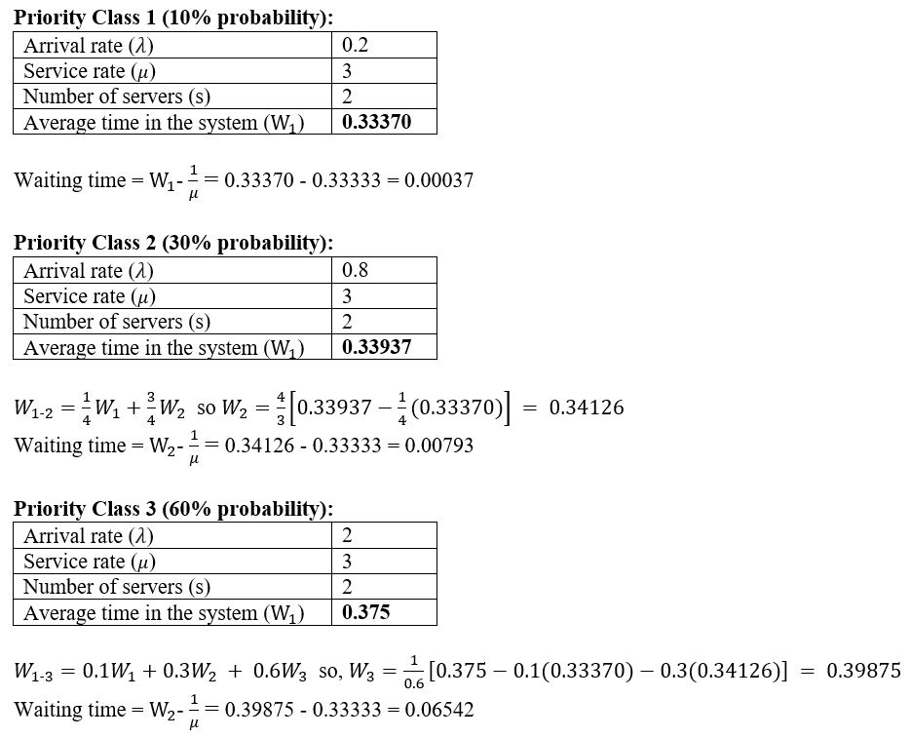
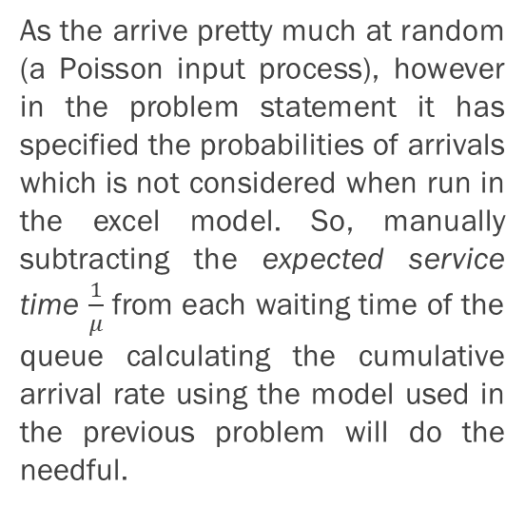
Preemptive Priorities Queue Workaround
As the arrive pretty much at random (a Poisson input process), however in the problem statement it has specified the probabilities of arrivals which is not considered when run in the excel model. So, manually subtracting the expected service time $\frac{1}{μ}$ from each waiting time of the queue calculating the cumulative arrival rate using the model used in the previous problem will do the needful.

Slide 19
Preemptive Priorities workaround results (s=2)

Slide 20
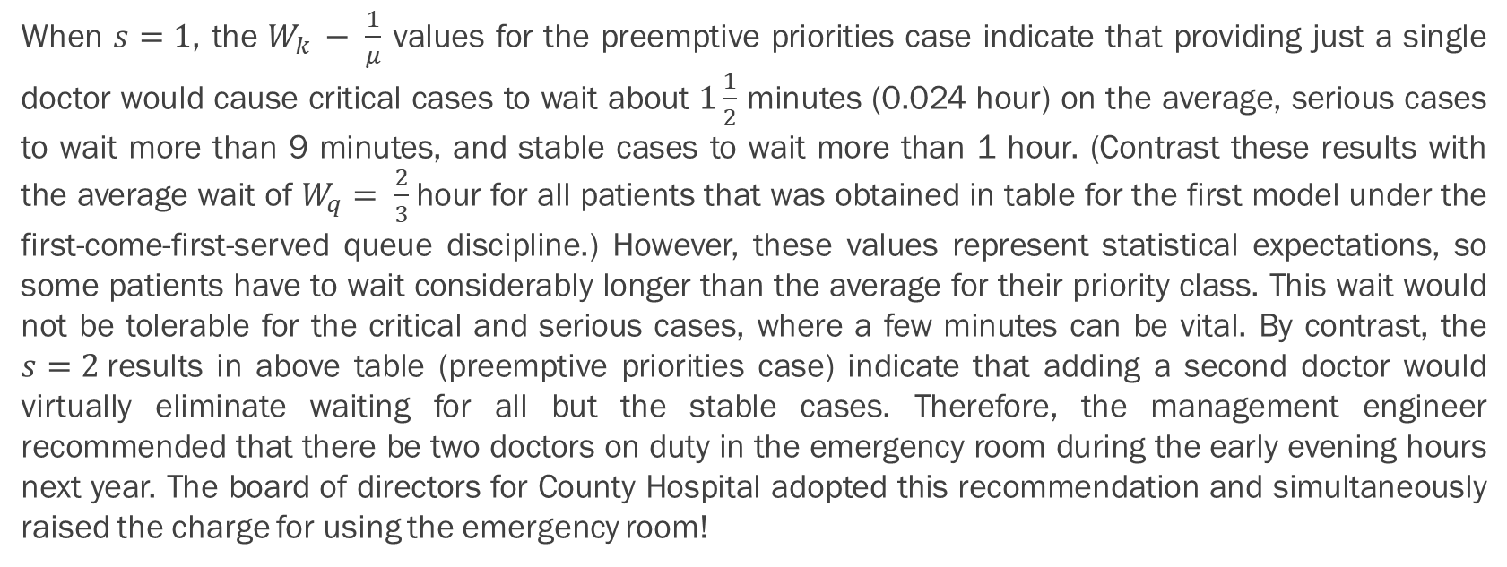
Conclusion
When $s=1$, the $W_{k }− \frac{1}{μ}$ values for the preemptive priorities case indicate that providing just a single doctor would cause critical cases to wait about $1\frac{1}{2}$ minutes (0.024 hour) on the average, serious cases to wait more than 9 minutes, and stable cases to wait more than 1 hour. (Contrast these results with the average wait of $W_{q}= \frac{2}{3}$hour for all patients that was obtained in table for the first model under the first-come-first-served queue discipline.) However, these values represent statistical expectations, so some patients have to wait considerably longer than the average for their priority class. This wait would not be tolerable for the critical and serious cases, where a few minutes can be vital. By contrast, the $s=2$results in above table (preemptive priorities case) indicate that adding a second doctor would virtually eliminate waiting for all but the stable cases. Therefore, the management engineer recommended that there be two doctors on duty in the emergency room during the early evening hours next year. The board of directors for County Hospital adopted this recommendation and simultaneously raised the charge for using the emergency room!

Slide 21
Cost Benefit Analysis
The management engineer also calculated total cost to strengthen its above conclusion. So, we could see that when we have two doctor it does costs less considering the waiting cost to be $100 per hour

Slide 22
Similar Simulation using R
Preemptive QUEUE OUTPUT
Non - Preemptive QUEUE OUTPUT

Slide 23
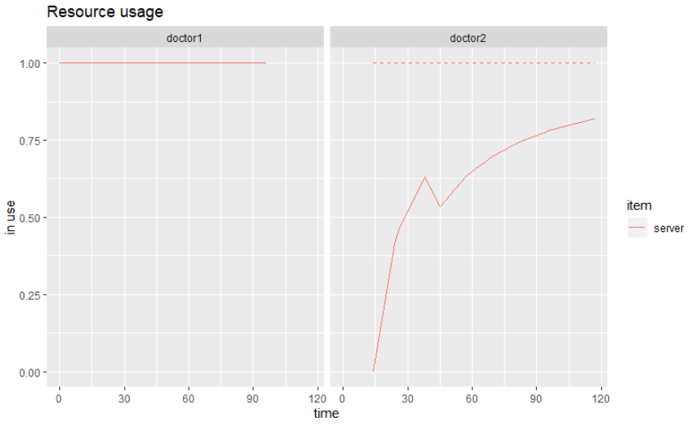
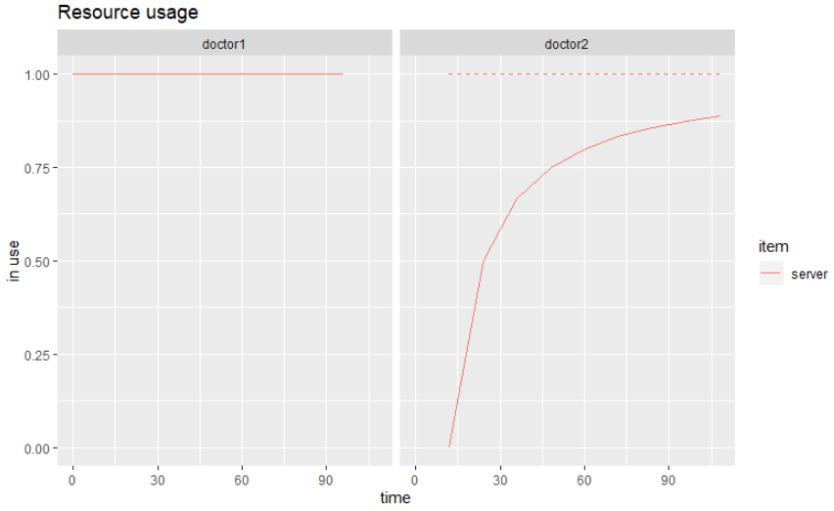
Similar Simulation using R
Preemptive QUEUE RESOURCE USAGE
Non - Preemptive QUEUE RESOURCE USAGE

Slide 24
THANK YOU

